Slide 1
Capstone Project-Battle of Neighborhoods:
Is Ahmedabad City similar to Toronto city?
By,
Mohit Rajput

Slide 2
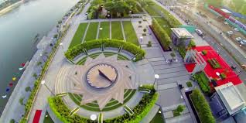
About Ahmedabad
AHMEDABAD:
Ahmadabad has emerged as an important economic and industrial hub in India. It is the second largest producer of cotton in India, and its stock exchange is the country's second oldest. Cricket is a popular sport in Ahmadabad, which houses the 54,000-seat Sardar Patel Stadium. The effects of liberalization of the Indian economy have energized the city's economy towards tertiary sector activities such as commerce, communication and construction. Ahmadabad's increasing population has resulted in an increase in the construction and housing industries resulting in recent development of skyscrapers. (source: https://en.wikipedia.org/wiki/Ahmedabad)

Slide 3
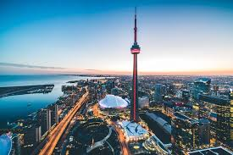
About Toronto
toronto:
Toronto is a prominent Centre for music, theatre, motion picture production, and television production, and is home to the headquarters of Canada's major national broadcast networks and media outlets. Its varied cultural institutions, which include numerous museums and galleries, festivals and public events, entertainment districts, national historic sites, and sports activities, attract over 25 million tourists each year. Toronto is known for its many skyscrapers and high-rise buildings, in particular the tallest free-standing structure in the Western Hemisphere, the CN Tower. (source: https://en.wikipedia.org/wiki/Toronto)

Slide 4
Objective (Business Problem)
Using segmentation and clustering, we hope we can determine:
The similarity or dissimilarity of both cities
Classification of area located inside the city whether it is residential, tourism places, or others
Find an optimal location for establish a business
Restaurant food popularity
Identify optimal place for Bus station, Railway station or Airport

Slide 5
Data
The data we used in this project is in .csv format. Hence, there are no accurate data is available for Ahmedabad City, so all data is collected by manually and Wikipedia. For, Toronto City we used Wikipedia’s List_of_postal_codes_of_Canada_M.html and Toronto geospatial data.
The data acquired from Wikipedia pages and restructure to csv file for easier manipulation and reading. Both Ahmedabad and Toronto city necessary data files uploaded to my GitHub link for references. In, this data each row is referred by neighborhood.

Slide 6
Data
Links to websites which are used to get data:
• https://en.wikipedia.org/wiki/Category:Neighbourhoods_in_Ahmedabad
• https://www.latlong.net/
• https://www.census2011.co.in/census/city/314-ahmedabad.html
Link to the data files are:
• https://github.com/mohit-n-rajput/Coursera_Capstone/blob/master/data/Geospatial_Coordinates.csv
• https://github.com/mohit-n-rajput/Coursera_Capstone/blob/master/data/List_of_postal_codes_of_Canada__M.html
• https://github.com/mohit-n-rajput/Coursera_Capstone/blob/master/data/Geospatial_Coordinates.csv

Slide 7
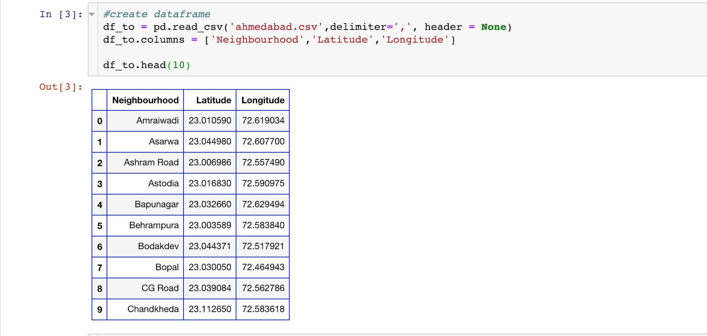
DATA
Another aspect to consider for this project is the Foursquare data. I believe that the data as good as provided, meaning although we are using Foursquare data for segmentation and clustering, the amount and accuracy of data captured can't 100% determine correct classification in real world. Also, there are no accurate data about Ahmedabad neighborhood, it's all collected by me.
Ahmedabad City Neighborhood Data

Slide 8
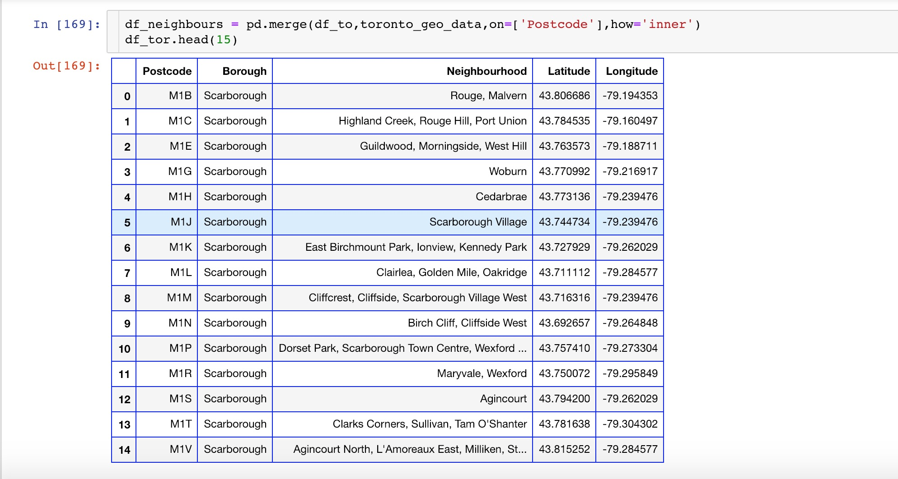
DATA
Toronto City Neighborhood

Slide 9
DATA
City data accessible through the FourSquare API:
This data will produce the following deliverables.
A list of all neighborhoods in Toronto, Ahmedabad with a different venues
A list of the top ten venues in each neighborhood
A ranking of all neighborhoods with a specific venue based on Review

Slide 10
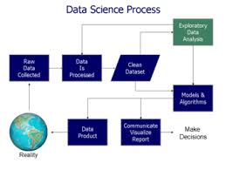
METHODOLOGY
In this project, we will use the basic methodology of data science methodology.
After the Business Problem Definition, Best analytic approach is chosen.
After that process of data analysis is done:
Data requirements
Data collection
Data processing
Data cleaning
Exploratory data analysis
Modeling and algorithms
Data product

Slide 11
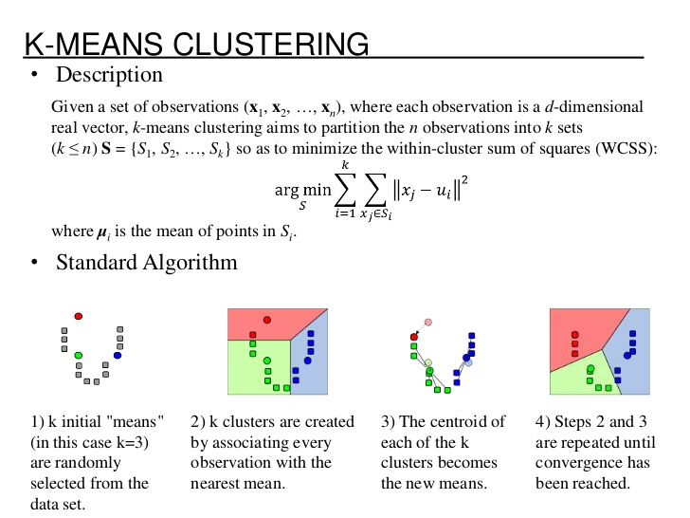
METHODOLOGY
Modeling and algorithms:
K-means clustering algorithm will be use to complete this task. And also, the Folium library to visualize the neighborhoods in Ahmedabad and Toronto and their emerging clusters.

Slide 12
METHODOLOGY
Data Product:
As a data product we have clusters after apply the algorithm, this cluster are very helpful to comparing cities.

Slide 13
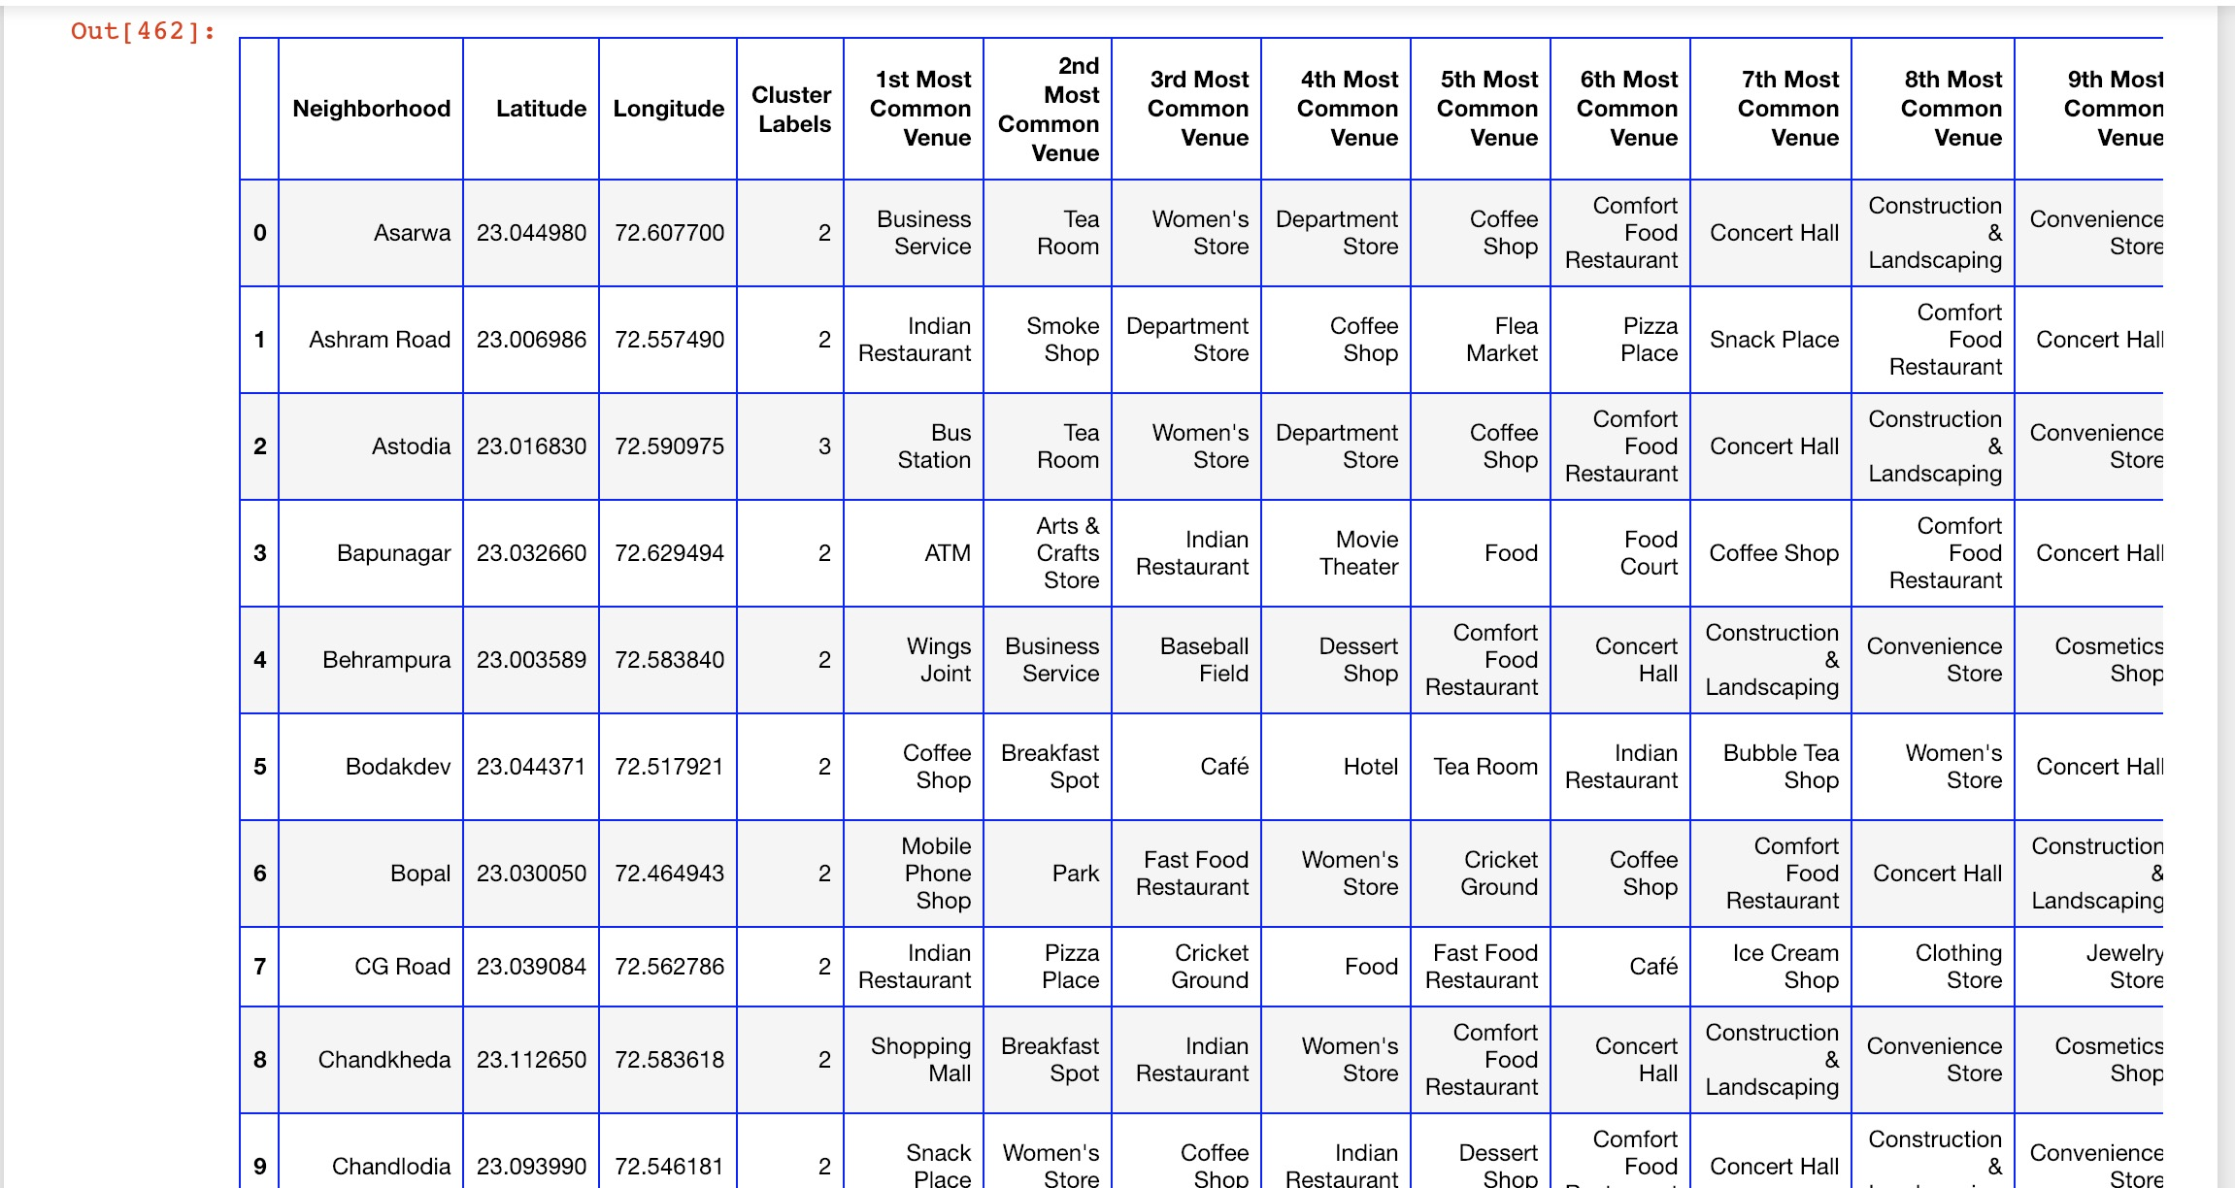
RESULTS
Ahmedabad City Popular Neighborhood’s place dataframe:

Slide 14
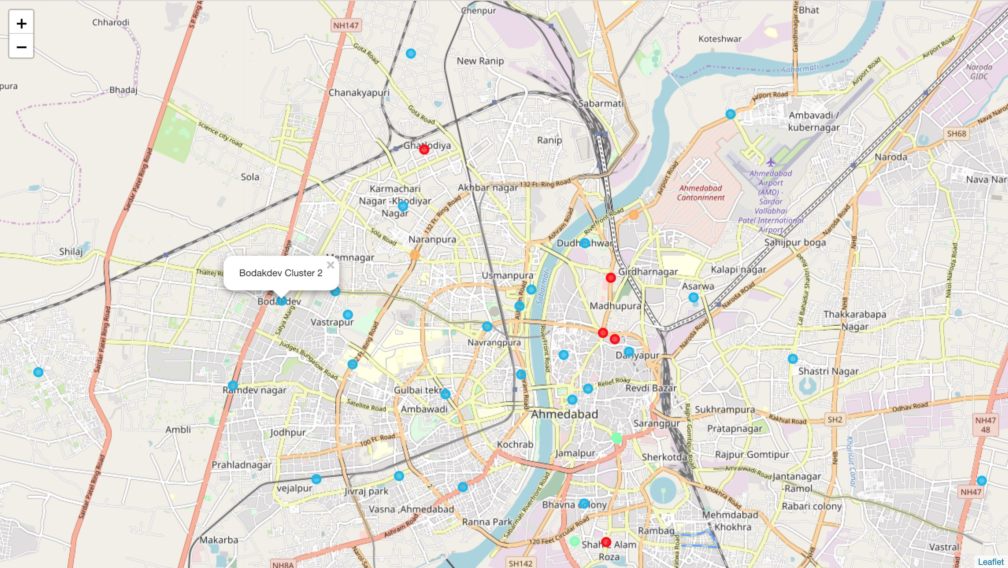
RESULTS
Ahmedabad City Popular Neighborhood’s place Cluster:

Slide 15
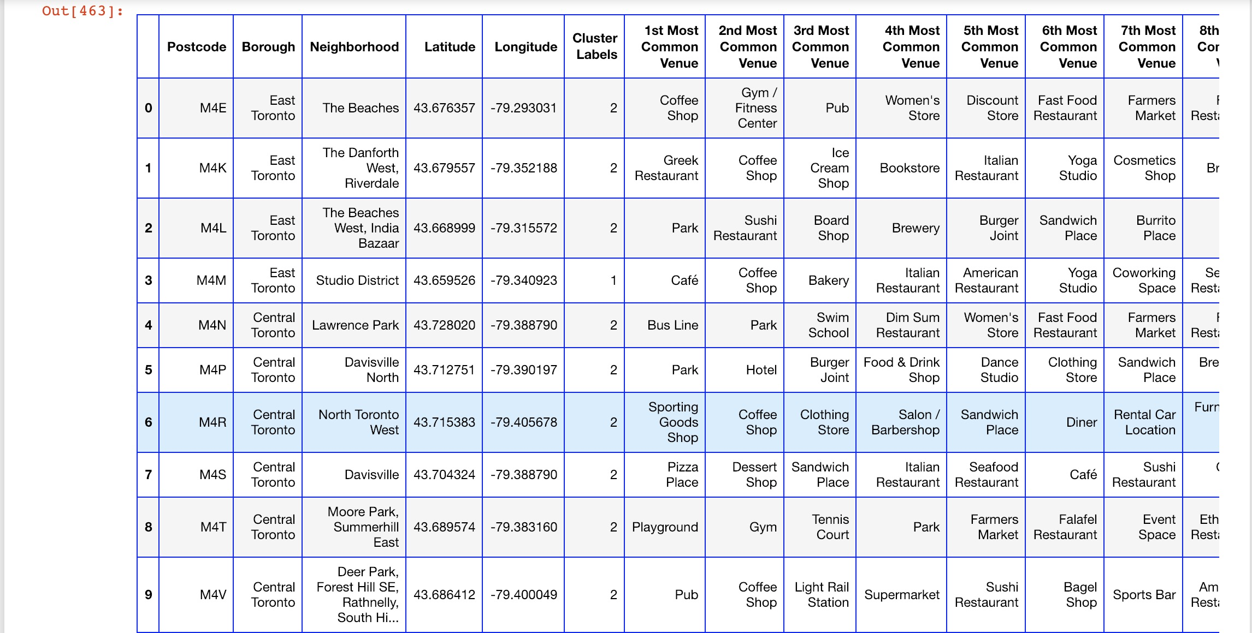
RESULTS
Toronto City Popular Neighborhood’s place dataframe:

Slide 16
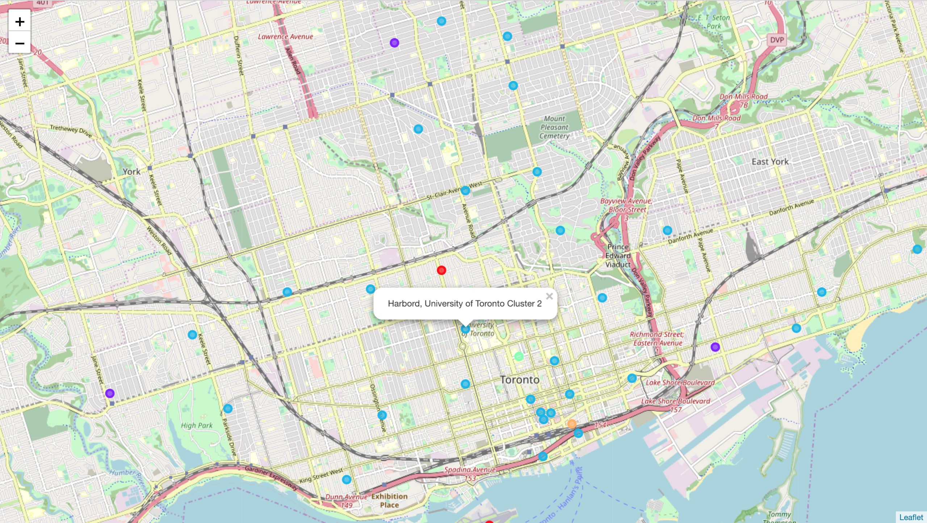
RESULTS
Toronto City Popular Neighborhood’s place Cluster:

Slide 17
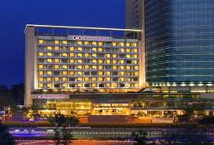
Discussion : For our business problem
From cluster and clustering map of Ahmedabad and Toronto, cluster-3 of Ahmedabad which also known as West Ahmedabad and cluster-3 of Toronto are seen like similar in form of Coffey-shop, pizza-Restaurant, Fast-food Restaurant, Café.
WEST AHMEDABAD

Slide 18
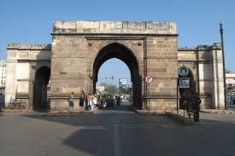
Discussion : For our business problem
For Tourism, As per the Ahmedabad cluster -1 it seems like Tourism place, also there heritage place Delhi Darwaza is situated. It’s also have lake in this cluster And the Ahmedabad cluster-3 seems like Residential Area.

Slide 19
Discussion : For our business problem
For Toronto no data shown for tourism in clusters, all clusters seems like residential area.
For Optimal place for Business, Ahmedabad cluster-3 and Toronto cluster-3 are seems like good option for Business like Coffey-shop, fast-food restaurant, women’s store, boutique, Bookstore, pool, Hotel.
From the both cluster of Ahmedabad and Toronto we can say that in Vegetarian ,Mexican, Fast-food ,pizza and Coffey shop are very famous.
For Optimal location near Bus-station or Railway station,
In Ahmedabad From the Cluster-4 ,we can say that Dani lambda and Astodia are optimal location for Bus-station . There are no data for Bus-station or Railway station in Toronto City.

Slide 20
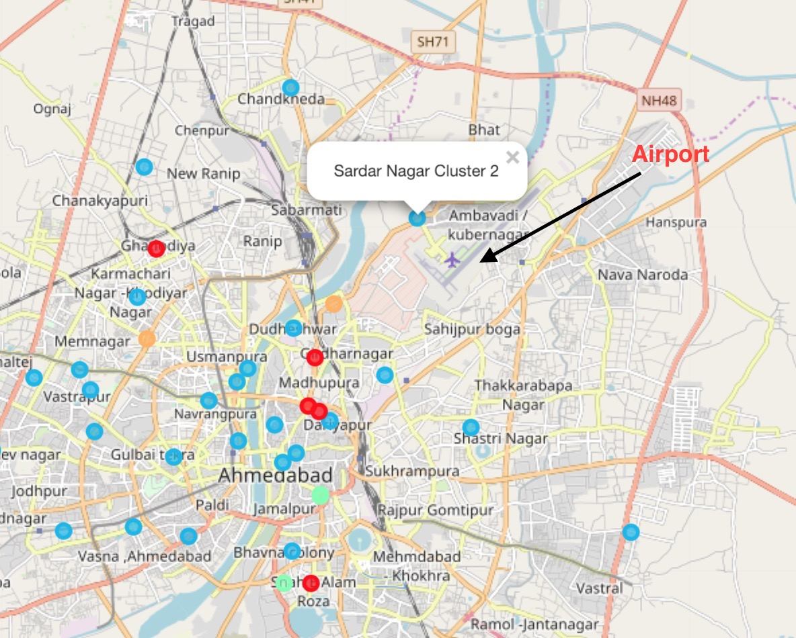
Discussion : For our business problem
For Airport Facility, a. In Ahmedabad city, from the Cluster-2 Ahmedabad we can
say that Sardar nagar is near from the Airport and Best Option for Hotel Business, because very few hotel around hem.

Slide 21
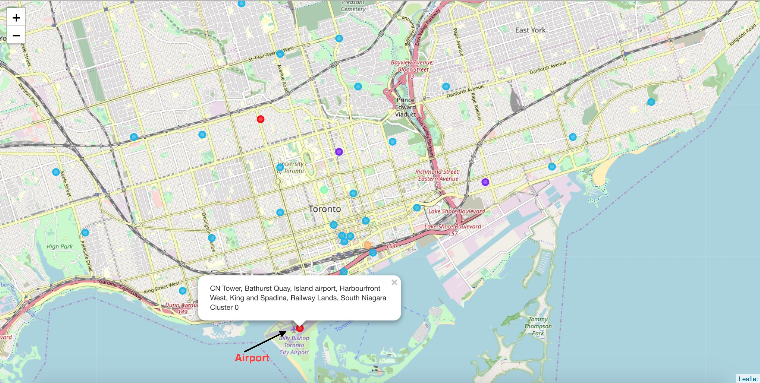
Discussion : For our business problem
In Toronto City, From the Toronto-City-Cluster 1 we can say that CN Tower, Bathurst Quay are best for airport facility, and also airport longue is there

Slide 22
Conclusion
West Ahmedabad is little bit similar like Toronto.
Ahmedabad have good heritage places and also have Residential Area, and all Toronto area are look like Residential Area.
Good business option in Ahmedabad and Toronto are Coffey-shop, fast-food restaurant, women’s store, boutique, Bookstore, pool, Café.
Vegetarian, Mexican, Fast-food, Pizza and Chinese food are famous in Ahmedabad and Canada.

Slide 23
Conclusion
For Bus and Railway Station Dani lambda and Astodia are optimal location in Ahmedabad.
For Airport Facility, CN Tower, Bathurst Quay in Toronto and Sardar Nagar in Ahmedabad are optimal place.
We can say that, Both Toronto and Ahmedabad City are optimal place for Business.

Slide 24
Thanks For Reading
BY,
MOHIT RAJPUT

